Slide 1
Problem Statement
Integrated Common Services to Common People
By: Shravan Kumar
Faculty of Engineering and Technology, DMIHER Wardha Maharashtra

Slide 2
Unique Idea Brief (Solution)
This platform offers a unified solution by integrating various educational services like admissions, learning materials, mentorship, and more in one place.
Designed to be intuitive and easy to navigate, ensuring users can quickly find and utilize the resources they need.

Slide 3
Features Offered
Comprehensive Admission Portal
Marketplace for Learning Materials
Industrial Training and Job Assistance
Online Mentorship and Teacher Directory
Interactive Activities Section
User Profile Management

Slide 4
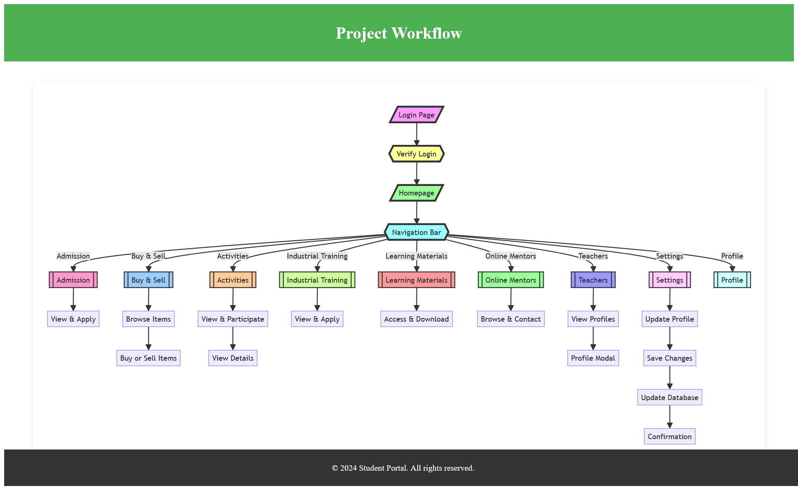
Process flow

Slide 5
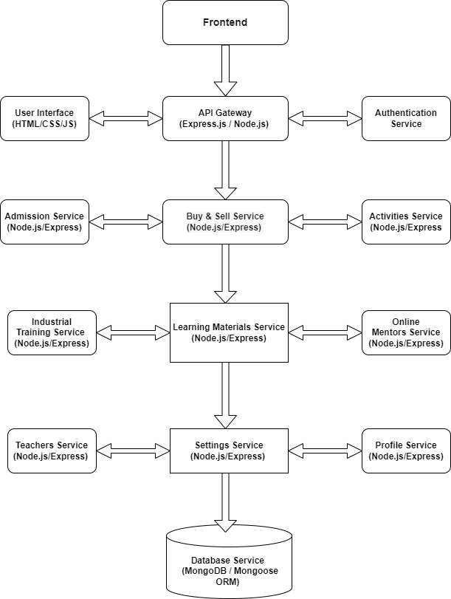
Architecture Diagram

Slide 6
Technologies used
FRONTEND
HTML
JavaScript
CSS
BACKEND
NodeJs
ExpressJs
MongoDB
Mongoose Compass
APIs & Libraries
Axios
Cors
Body-Parser
Development Tools
Visual Studio Code IDE
Other Technologies
bcrypt.js
dotenv

Slide 7
Conclusion
This platform integrates various educational services and resources into a single, accessible portal.
By offering a diverse range of tools and support, this app significantly improve the learning journey for students.
The intuitive and responsive design ensures seamless navigation and a positive user experience across all devices.
Through easy access to mentorship, training, and educational materials, the app empower students and educators to achieve their goals efficiently.

